Slide 1
Capstone Presentation
Presented By Herbert Borek

Slide 2
Plan
Collect data
Explore it
Predict it
Visualize it

Slide 3
SQL

Slide 4
SQL
SELECT DISTINCT Fact.Sale.Package, Fact.Sale.Quantity, Fact.Sale.[Unit Price], Fact.Sale.[Tax Rate], Fact.Sale.[Total Excluding Tax], Fact.Sale.[Tax Amount], Fact.Sale.Profit, Fact.Sale.[Total Including Tax], Dimension.[Transaction Type].[Transaction Type], Dimension.Customer.Customer, Dimension.Customer.Category, Dimension.Customer.[Buying Group], Fact.Sale.[Invoice Date Key], Fact.Sale.[Delivery Date Key], Fact.[Transaction].[Is Finalized], Dimension.[Stock Item].[Lead Time Days], Dimension.[Stock Item].[Stock Item]
FROM Fact.Sale INNER JOIN
Dimension.Customer ON Fact.Sale.[Customer Key] = Dimension.Customer.[Customer Key] INNER JOIN
Fact.[Transaction] ON Dimension.Customer.[Customer Key] = Fact.[Transaction].[Customer Key] INNER JOIN
Dimension.Supplier ON Fact.[Transaction].[Supplier Key] = Dimension.Supplier.[Supplier Key] INNER JOIN
Dimension.[Transaction Type] ON Fact.[Transaction].[Transaction Type Key] = Dimension.[Transaction Type].[Transaction Type Key] INNER JOIN
Dimension.[Stock Item] ON Fact.Sale.[Stock Item Key] = Dimension.[Stock Item].[Stock Item Key]
WHERE (Dimension.Customer.Customer <> 'Unknown')

Slide 5
Python

Slide 6
Columns to split
Customer
== Customer, City
Stock Item
== Item, Item Characteristic
Item
== Item, Item Description
Date Keys
== Day, Month, Year

Slide 7
Values
Package:
Each, Packet, Pair, Bag
Is Finalized:
True, False
Customer:
Tailspin Toys
Item:
???
Years:
2013, 2014, 2015, 2016

Slide 8
Comparison
2013
2016
Is Finalized: 0.925891
Lead Time Days: 1262.702388
Profit: 39413.354076
Quantity: 4095.175273
Tax Amount: 11805.270094
Tax Rate: 1532.491472
Total Excluding Tax: 78701.735755
Total Including Tax: 90507.005849
Unit Price: 4588.421508
Is Finalized: 0.923867
Lead Time Days: 1227.572708
Profit: 38571.695930
Quantity: 4282.921496
Tax Amount: 11414.962474
Tax Rate: 1515.044784
Total Excluding Tax: 77503.646931
Total Including Tax: 88918.609405
Unit Price: 4427.920735

Slide 9


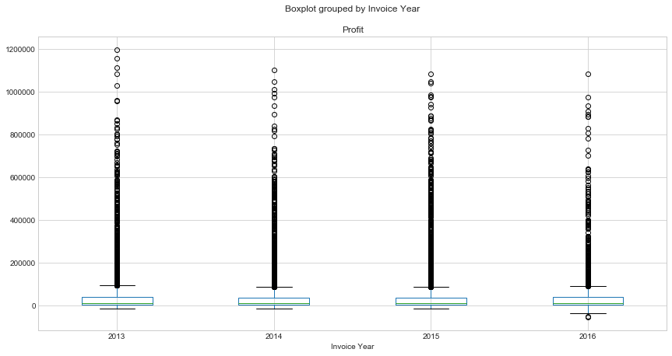




Slide 10
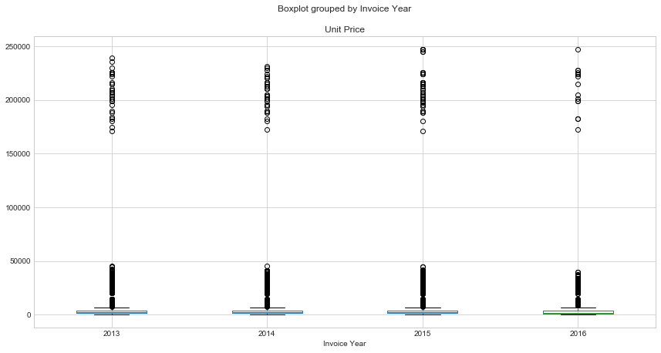

Slide 11
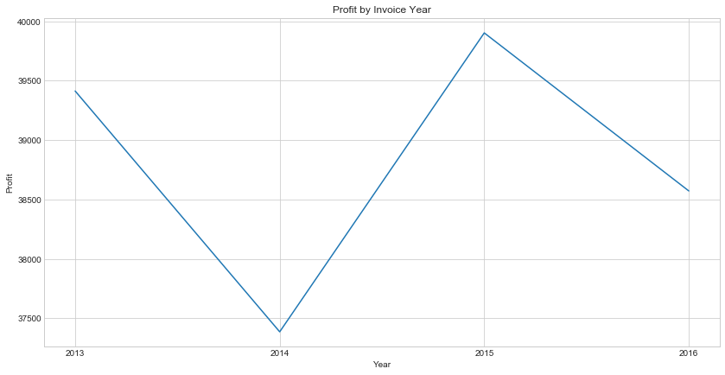

Slide 12
Calculated Variables
Reorder Point
(Average Daily Usage * Average Lead Time Days) + ((Maximum Lead Time * Maximum Daily Usage) – (Average Lead Time Days * Average Daily Usage))
Demand
Average of profits by product for each month
Return-On-Investment
(Profit / (Total Excluding Tax – Profit)) * 100
Percent Profit
Profit / Total Excluding Tax

Slide 13
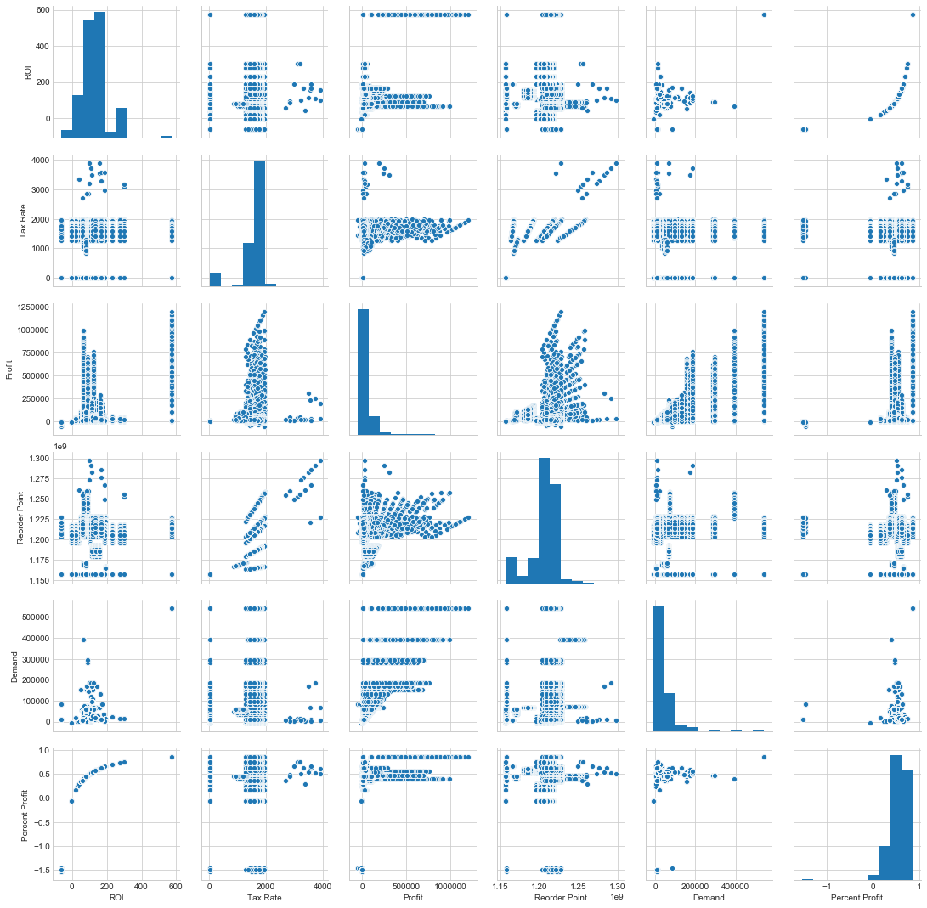

Slide 14
R

Slide 15
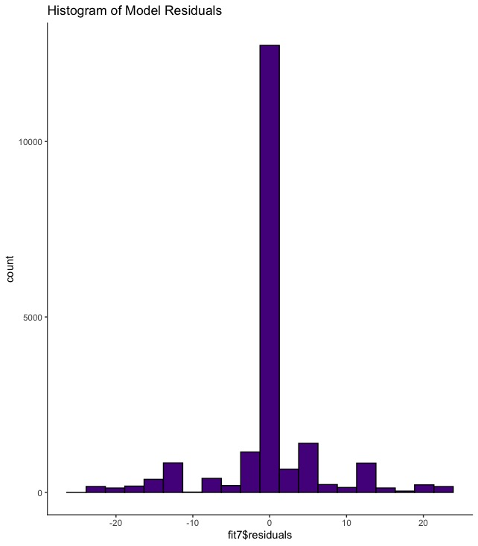
Predictive Models
ROI ~ Package + Profit + Tax Amount + Unit Price + Item + Reorder Point + Demand + Percent Profit

Slide 16
Power BI

Slide 17
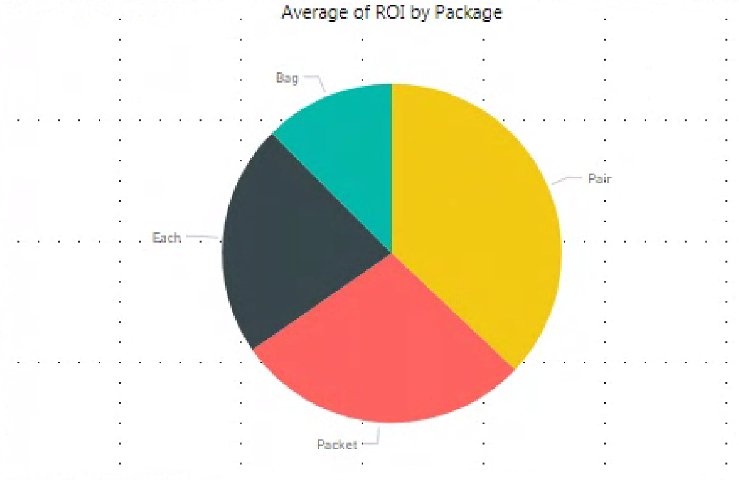
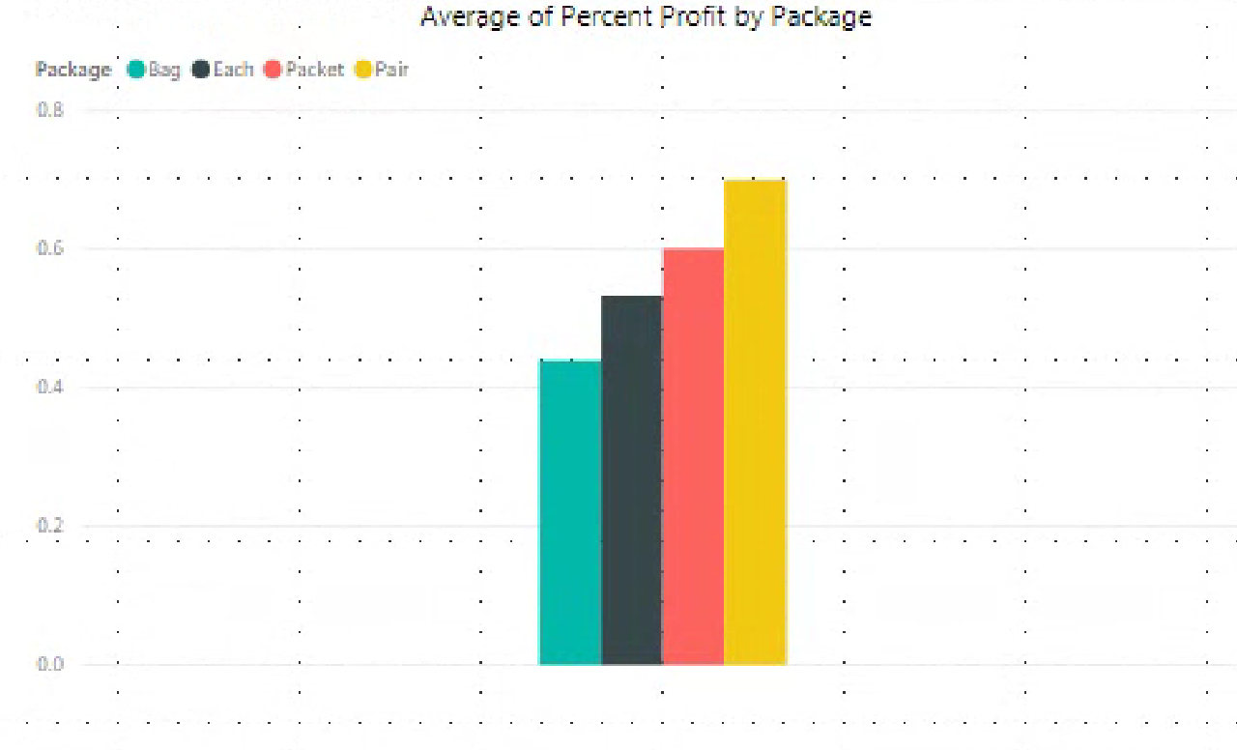
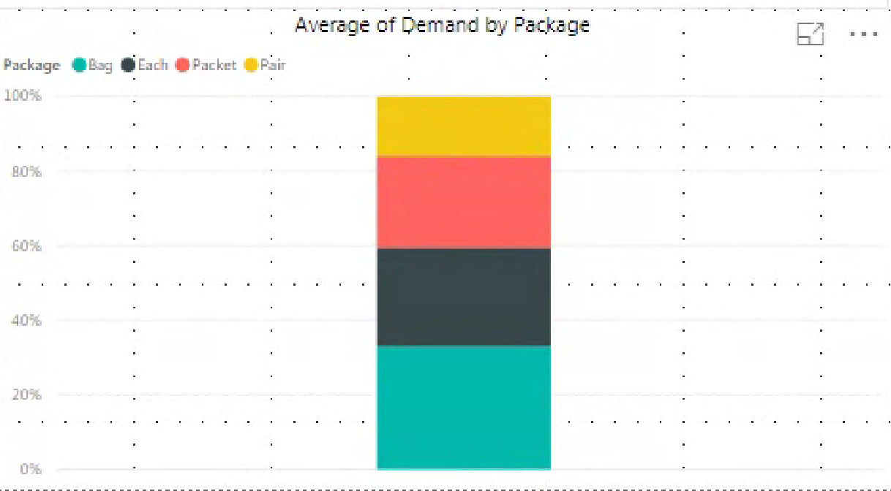
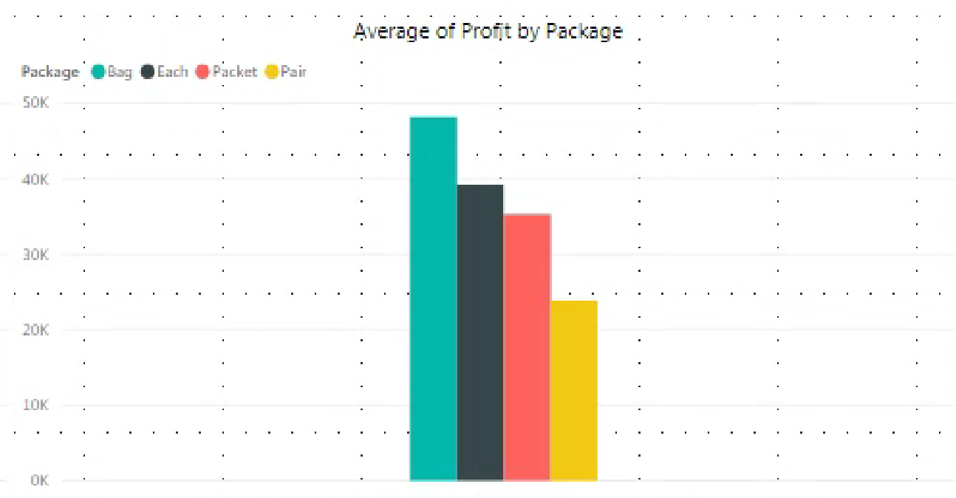

Slide 18
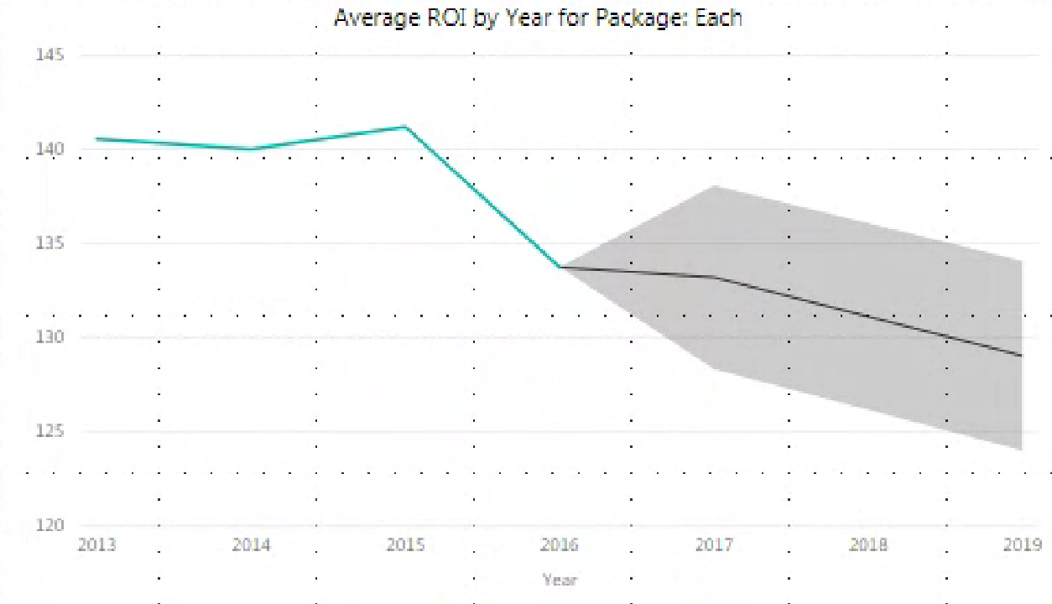
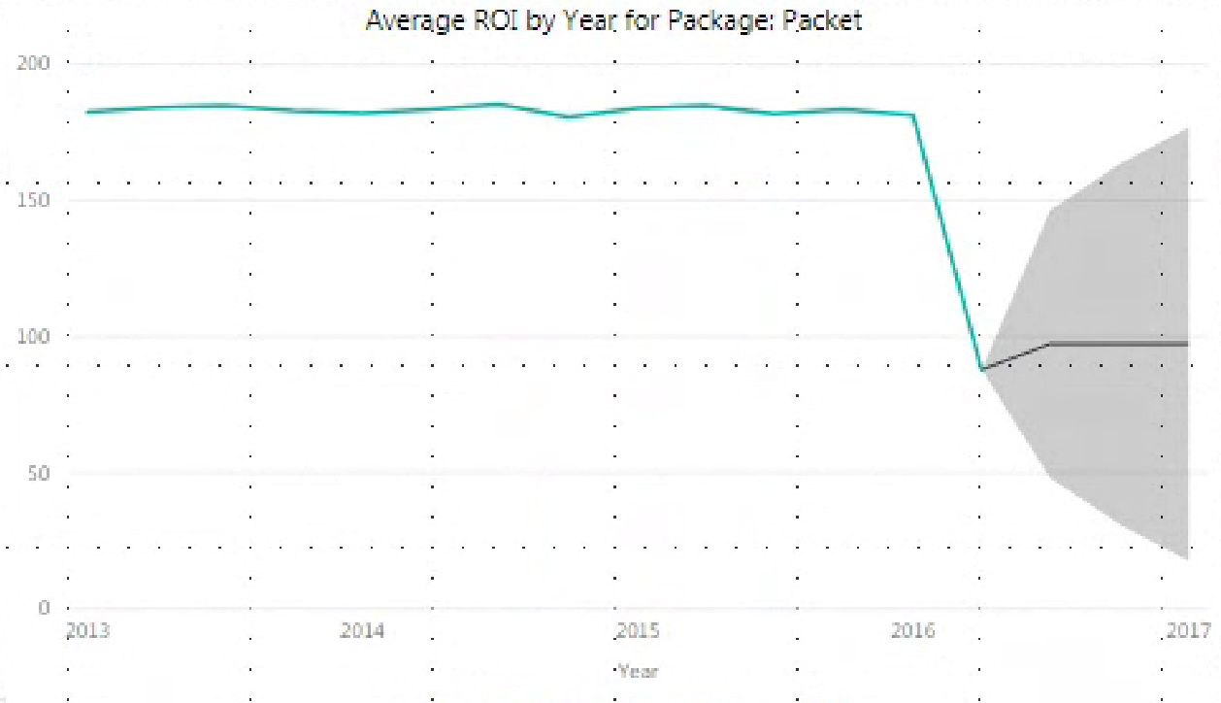
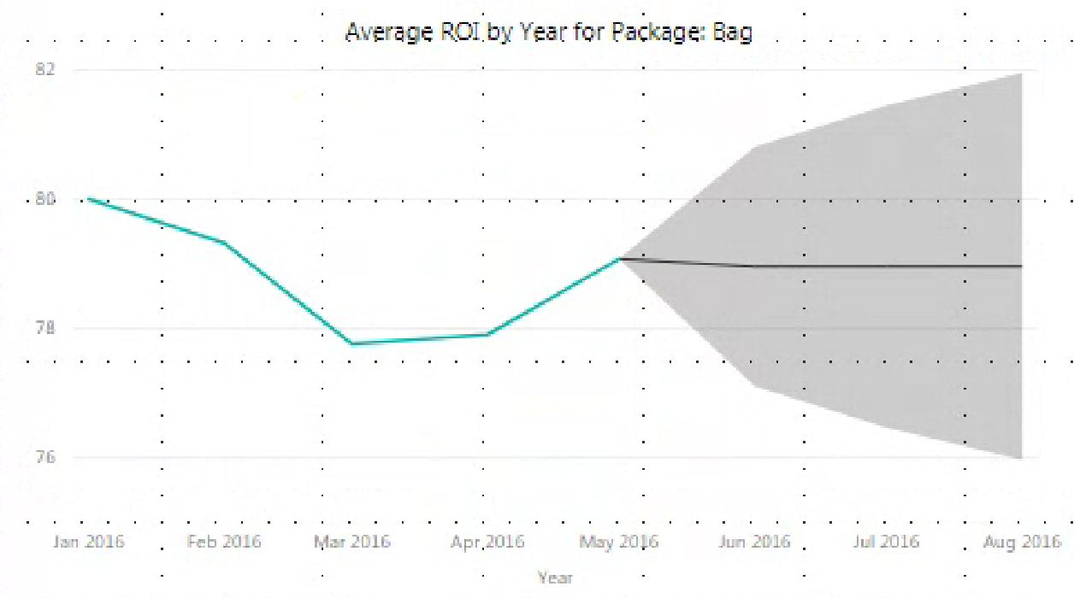
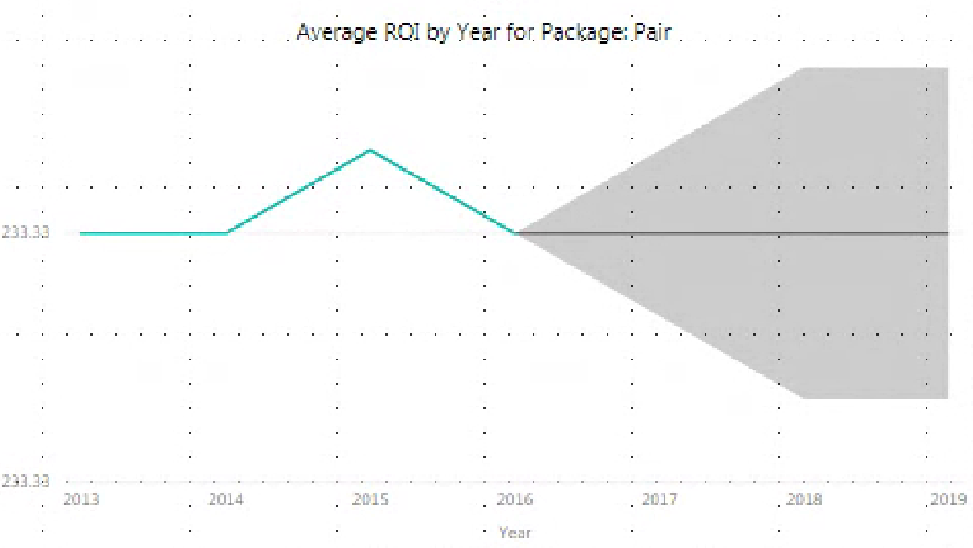

Slide 19
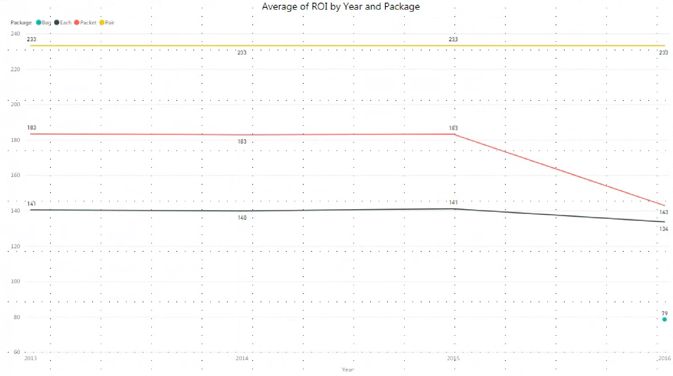

Slide 20
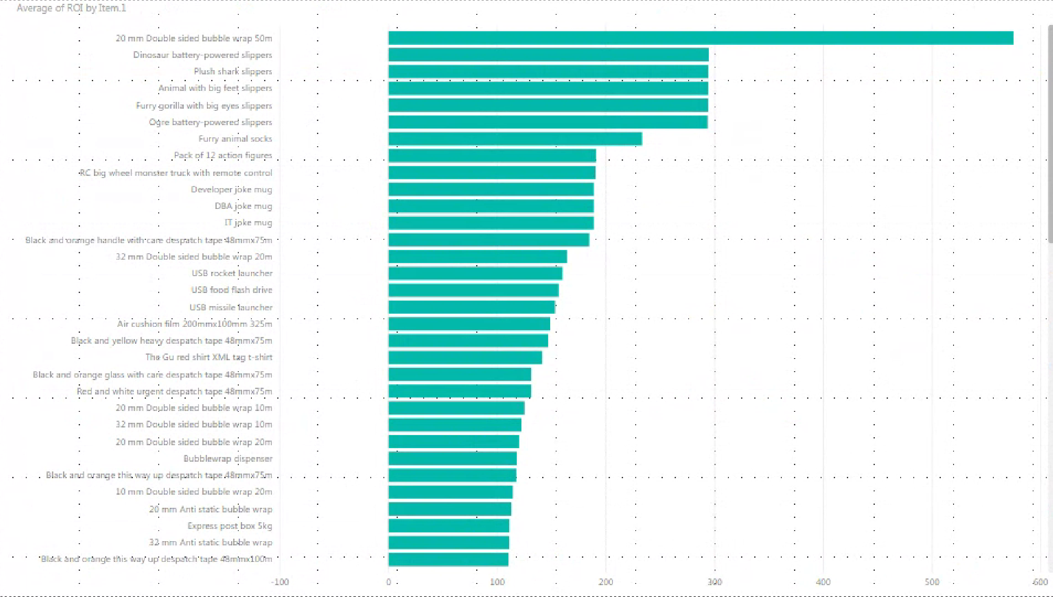
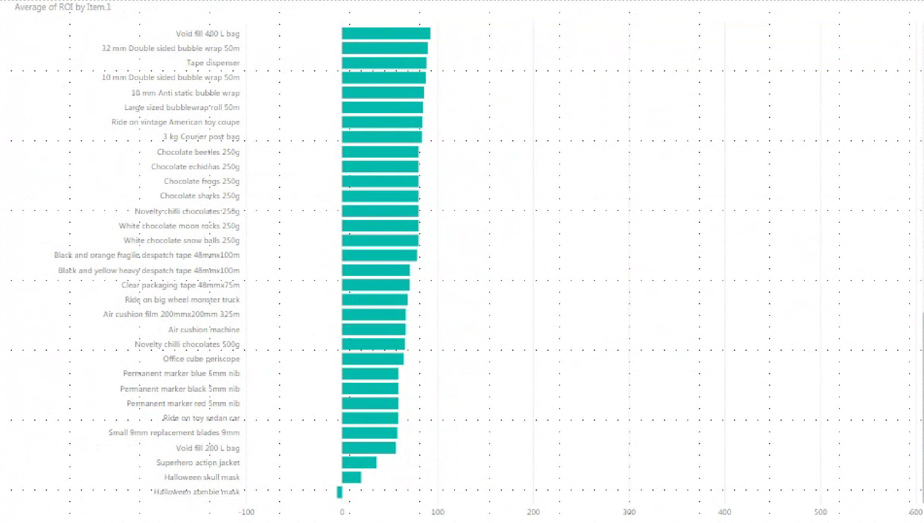

Slide 21
Recommendations

Slide 22
Recommendations
1. Optimize Pair Packages
2. Scope out Bag Package
3. Investigate Packet Package downfall

Slide 23
Thank you all for listening

